Slide 1

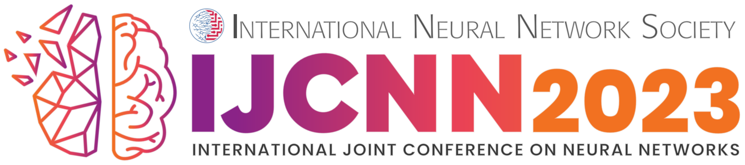
Demystifying Complex Treatment Recommendations
(A Hierarchical Cooperative Multi-Agent RL Approach)
Dilruk Perera^{1,2}, Siqi Liu^{1,3} and Mengling Feng^{1,2}
¹ Institute of Data Science, ² Saw Swee Hock School of Public Health, ³ NUS Graduate School - ISEP
National University of Singapore
19/06/2023

Slide 2
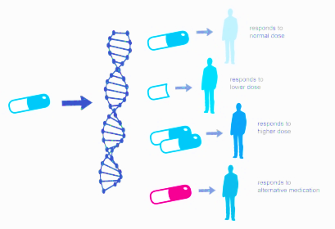

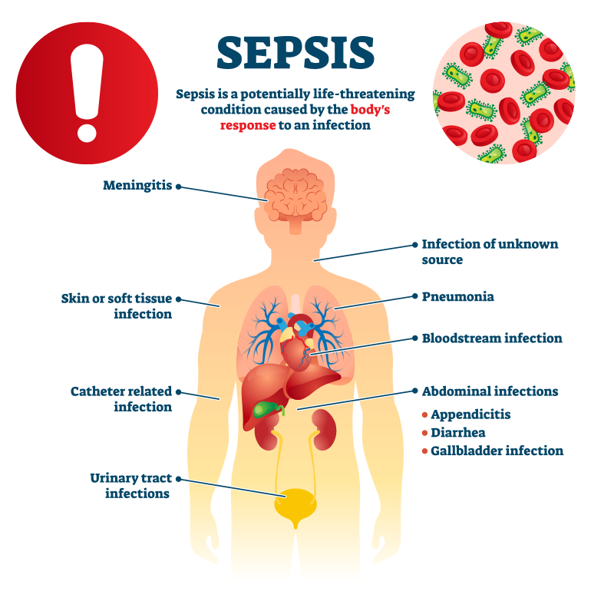
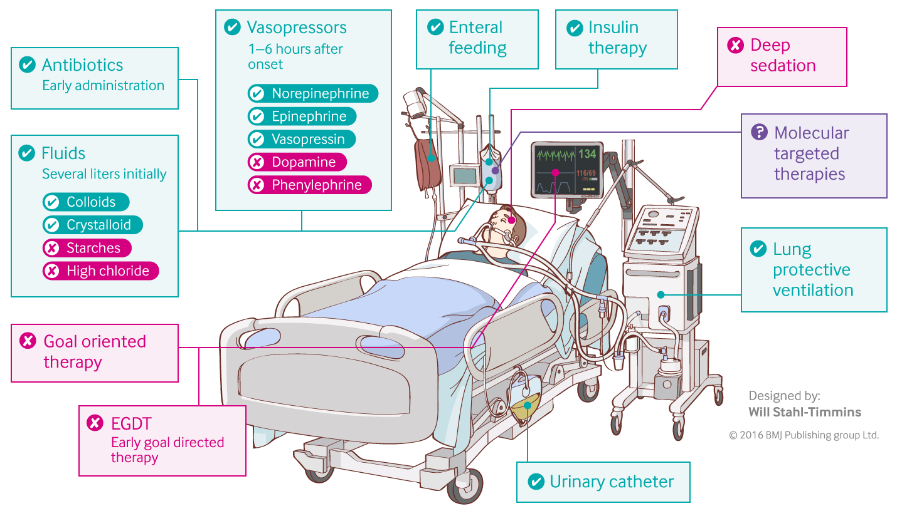
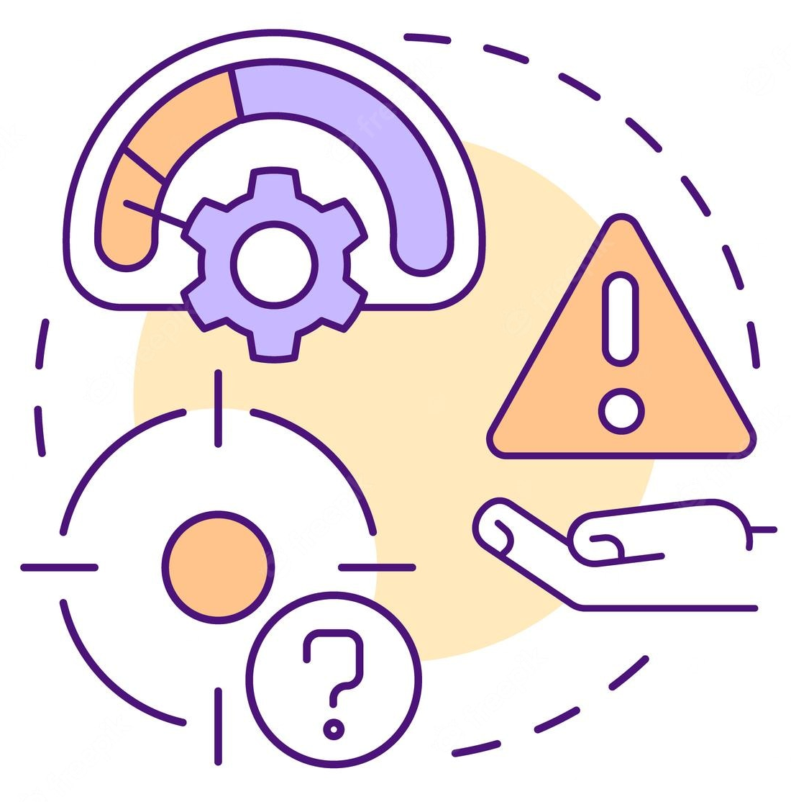
Complexity of the Treatment Recommendation Task
Personalized reactions to treatments
Effects on multiple organ systems
Wide range of potential treatments
Sub optimal treatment practices
Implication: Challenging for clinicians to make informed and confident treatment decisions

Slide 3









RL for Treatment Recommendations
Reinforcement Learning (RL) is a natural fit for the task:
  Sequential decision-making (continuous medical interventions)
  Maximizing long-term rewards (patient survival at discharge)
  Aims to surpass current policies (surpass sub optimal clinical practices)
Limitations of Existing RL Treatment Agents
  Overburdens a single agent to make complex decisions
  Sub-optimal patient state representations
Treatment Agent
Patient States

Slide 4

1: Overburdened Single Agent
Current solutions oversimplify the treatment recommendation task
  Overlooks hierarchical decision-making processes used in clinical practice
  Consider treatment recommendation as a singular decision and treatment space as a flat search space
  Expects a single agent to directly pick the optimal action that leads to best long-term outcomes

Slide 5
2: Sub-optimal Patient State Representations
Raw physiological features with high variance and lack of clear structure
  Results in unique samples (patient states) with lack of correlations among them
  Difficult to build effective prediction models
Lack of temporal context
  Patients’ history is a highly useful deciding factor
  Violation of Markov property in RL
Erroneous imputations
  Sparse Electronic Health Records (EHRs)
  Risks of biases and errors
  Hinder the detection of true patterns

Slide 6


Solution: Overview
A consolidated RL solution addressing the 2 limitations
      Hierarchical Multi-Agent RL (HMARL) approach
        Divide the burden among many agents
      Improved patient state representation
        Novel feature transformation techniques
        Incorporating temporal context
        Avoiding imputations

Slide 7
HMARL: Sepsis Use Case
A highly complex disease
  A severe infection leading to organ dysfunction
  Major causes of hospital deaths worldwide
  Affects multiple organ systems
  Optimal treatment policy is unknown
Typical treatment options:
  Vasopressors
  IV fluids
Image reference

Slide 8
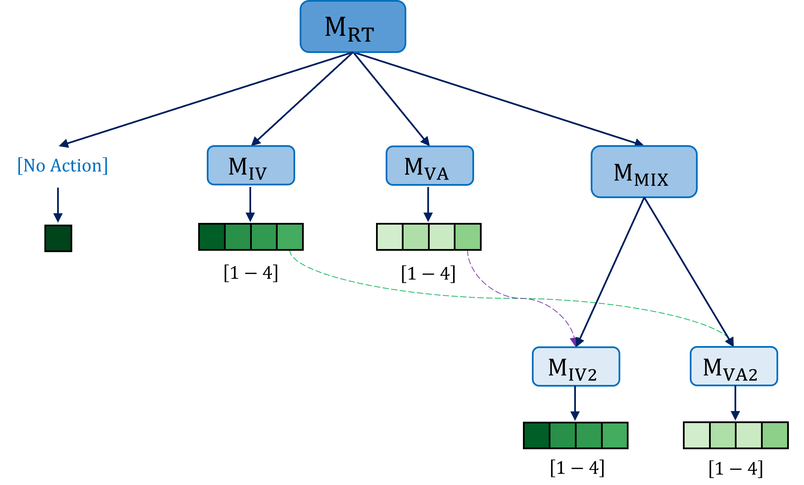
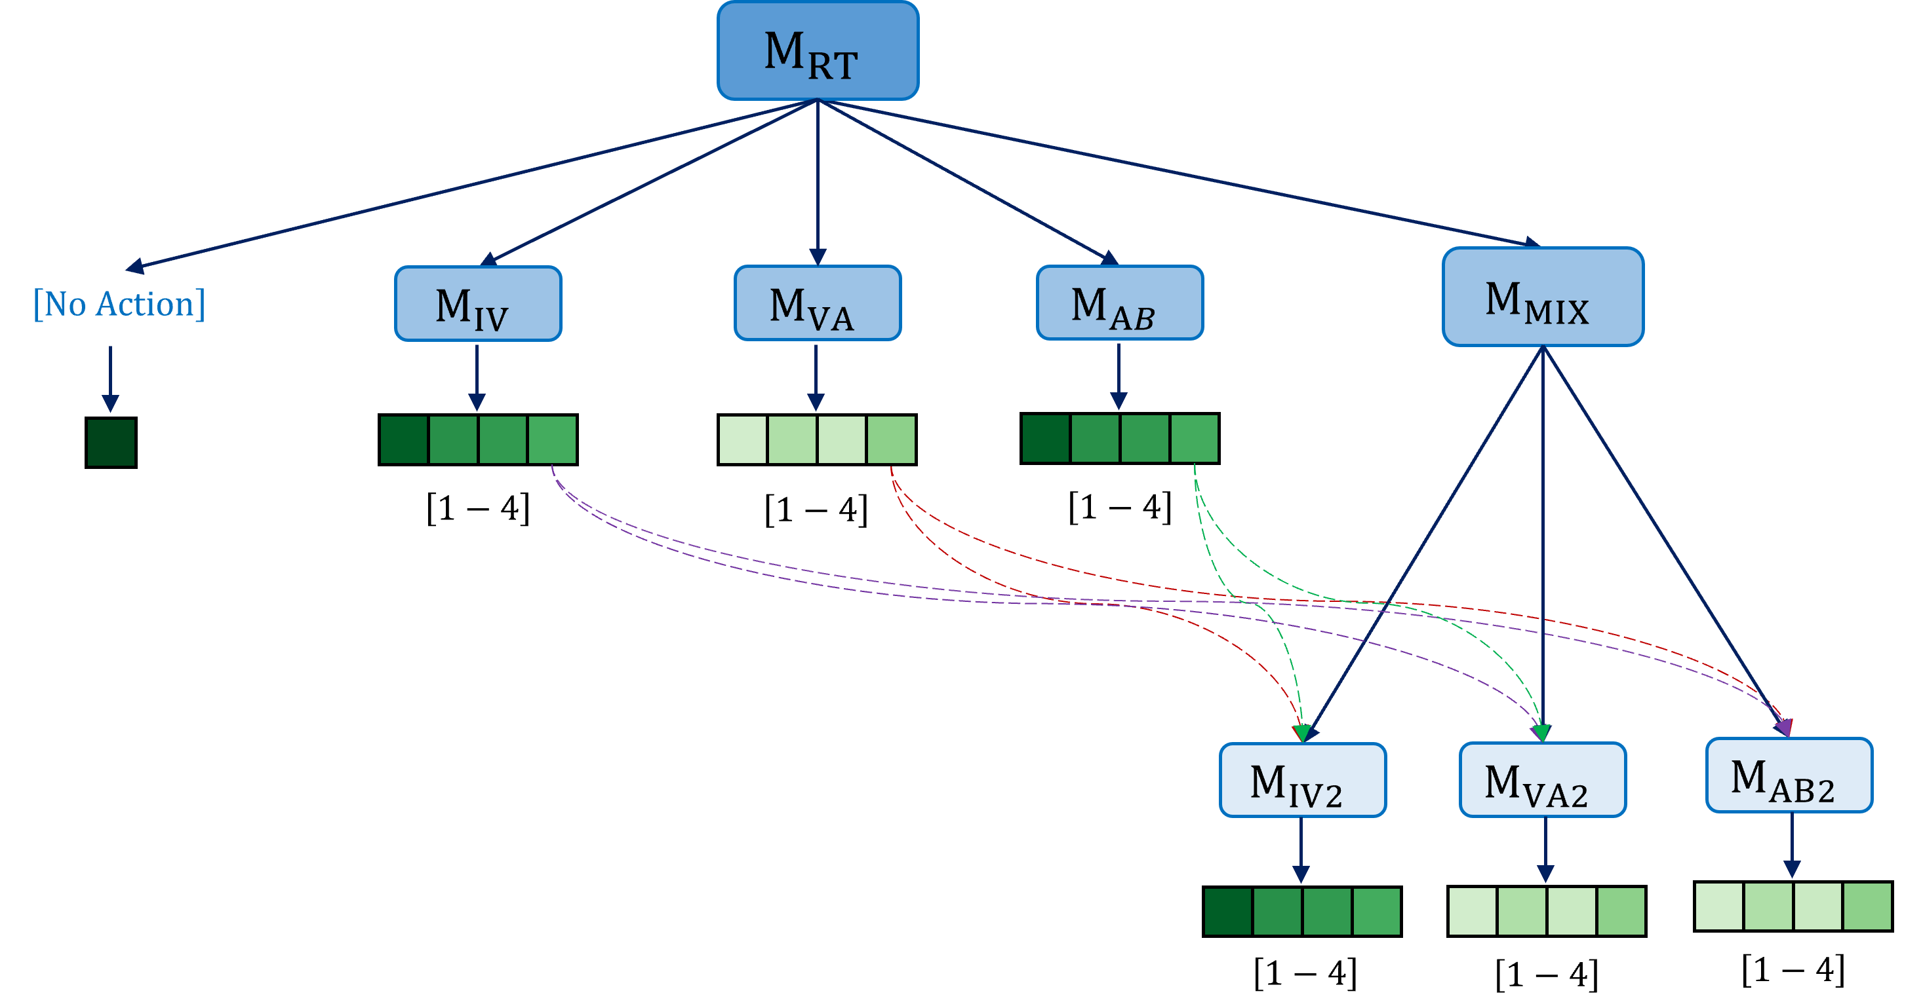
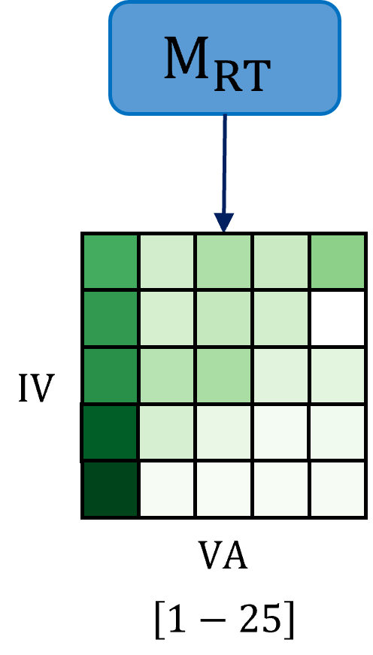
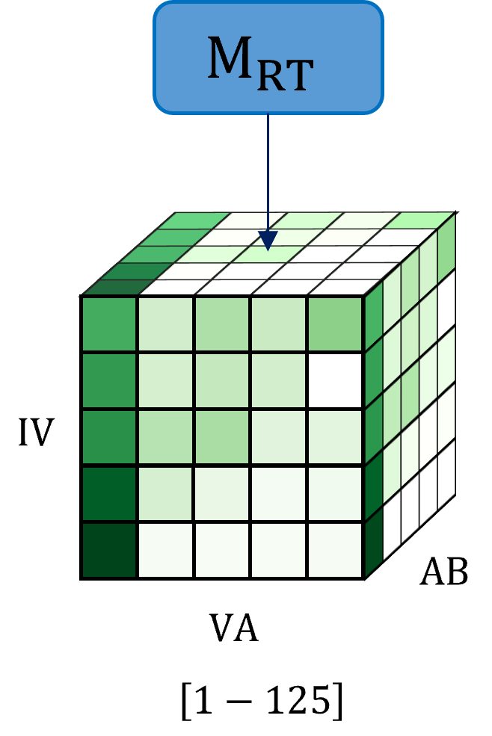


HMARL: Hierarchy
Standard RL Approach
Proposed HMARL Approach
$$RL Agent$$
$$RL Agent$$
Single Agent
High complexity
5 x 5 joint action space
Divide-and-conquer approach
  Divide the task into hierarchy of subtasks (using past frequent actions)
  Specialized agents solve subtasks and collectively make final decisions
  Reduced decision-making complexity for individual agents
  More focused and efficient training
Complexity is further reduced for higher discrete levels and higher number of treatments
  From 125 to 32 actions (under 5 discrete levels)
  From 1000 to 62 (under 10 discrete levels)

Slide 9
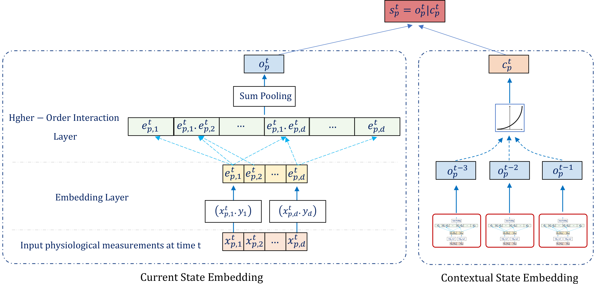
Patient State Representation Technique
Transform raw features into a dense homogeneous space
Manages the lack of clear structure and high variability
Incorporates recent patient history using recency
Helps overcome the lack of temporal context
Computes explicit interactions between the features to obtain patient states
Avoids the use of erroneous imputation techniques

Slide 10
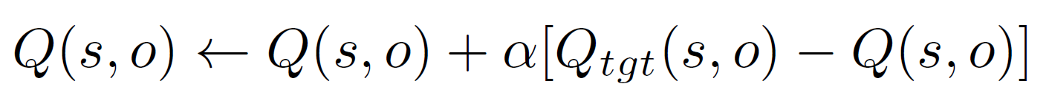
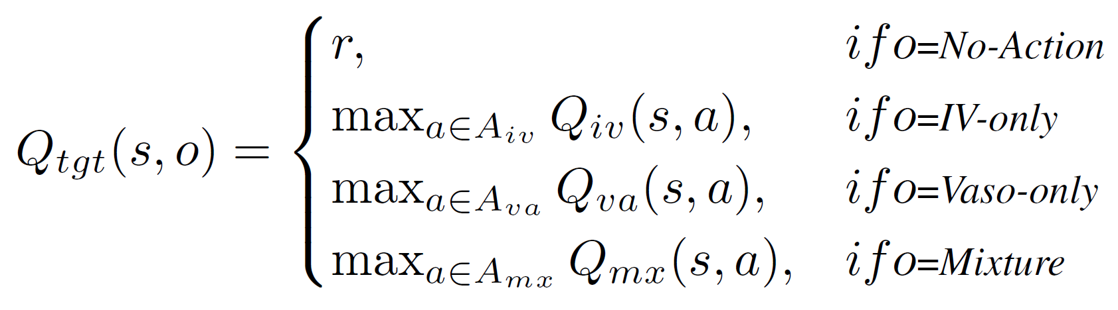
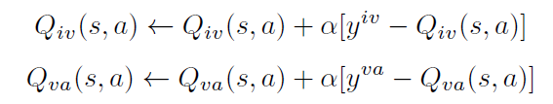
Q-Learning
At the root level, computes Q values for (state, option) pairs:
Q values for the mixture agent is learnt using the cooperation between lower-level agents as follows:

Slide 11
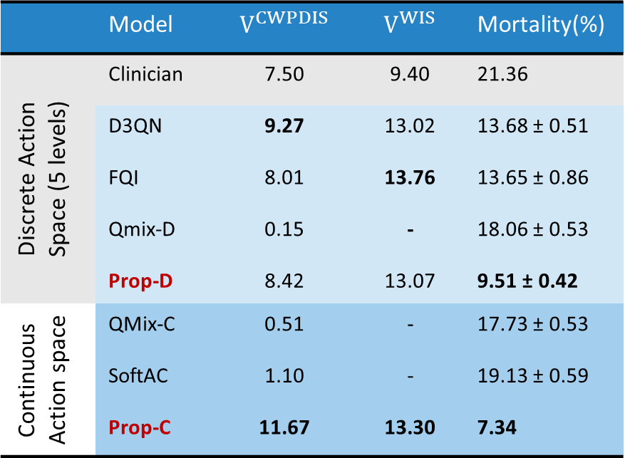
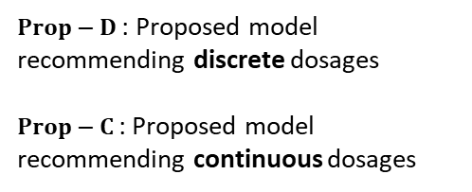
Experimental Results
Q1: Does the proposed approach lead to effective treatment policies?
 | Model | $$V^{CWPDIS}$$ | $$V^{WIS}$$ | Mortality(%)
Discrete Action Space (5 levels) | Clinician | 7.50 | 9.40 | 21.36
 | D3QN | 9.27 | 13.02 | 13.68 ± 0.51
 | FQI | 8.01 | 13.76 | 13.65 ± 0.86
 | Qmix-D | 0.15 | - | 18.06 ± 0.53
 | Prop-D | 8.42 | 13.07 | 9.51 ± 0.42
Continuous Action space | QMix-C | 0.51 | - | 17.73 ± 0.53
 | SoftAC | 1.10 | - | 19.13 ± 0.59
 | Prop-C | 11.67 | 13.30 | 7.34
$Prop−D$ : Proposed model recommending discrete dosages
$Prop−C$: Proposed model recommending continuous dosages
$V^{CWPDIS}$ : Average return calculated from full treatment sequences aligned with clinicians
$V^{WIS}$ : Average return calculated from partial treatment sequences aligned with clinicians

Slide 12
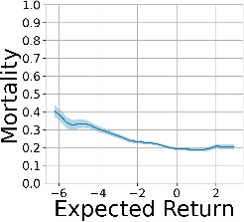
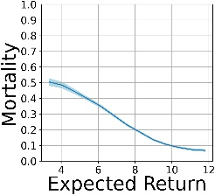
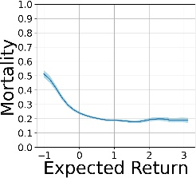
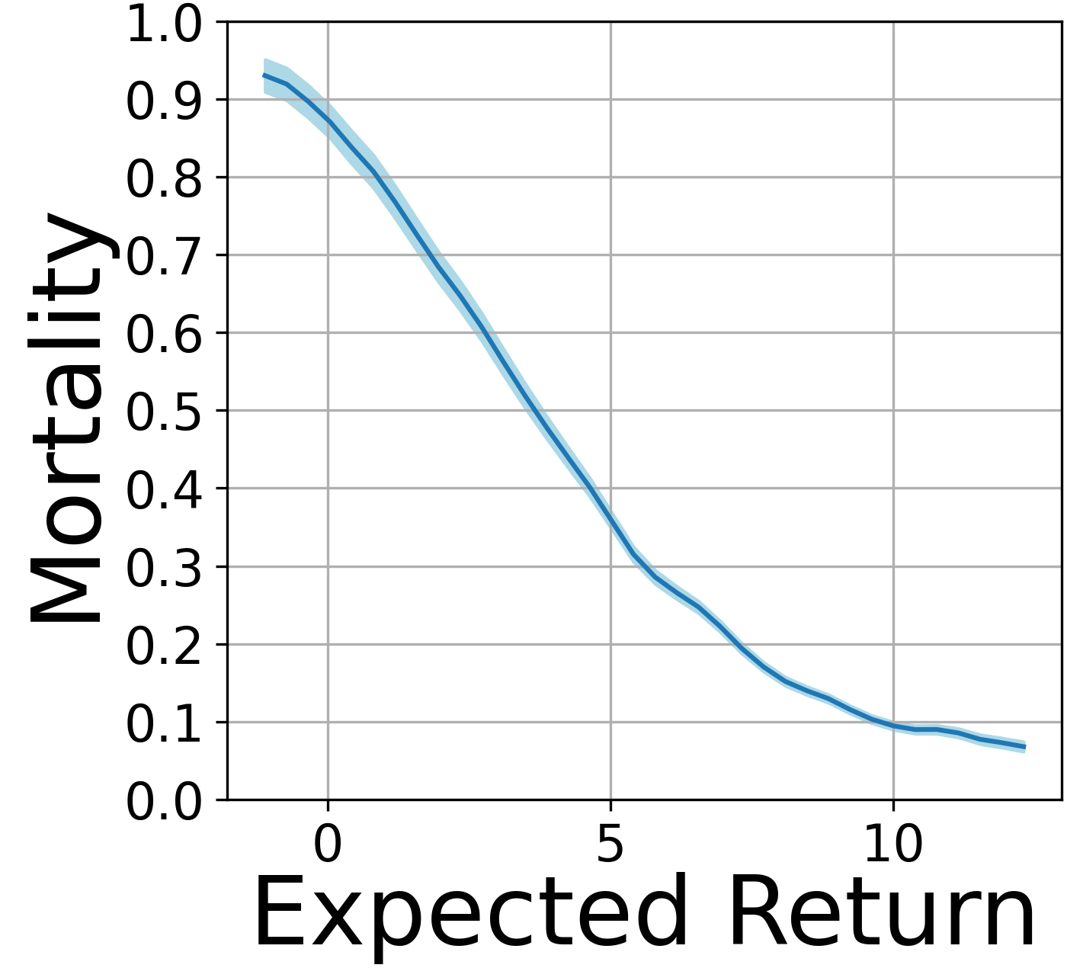
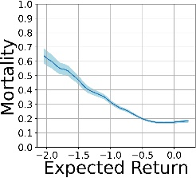
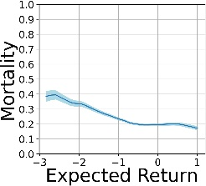
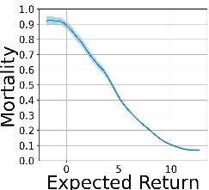

Experimental Results
Q1: Does the proposed approach lead to effective treatment policies?
$$FQI$$
D3QN
QMix-C
Prop-D
SoftAC
QMix-D
Prop-C

Slide 13
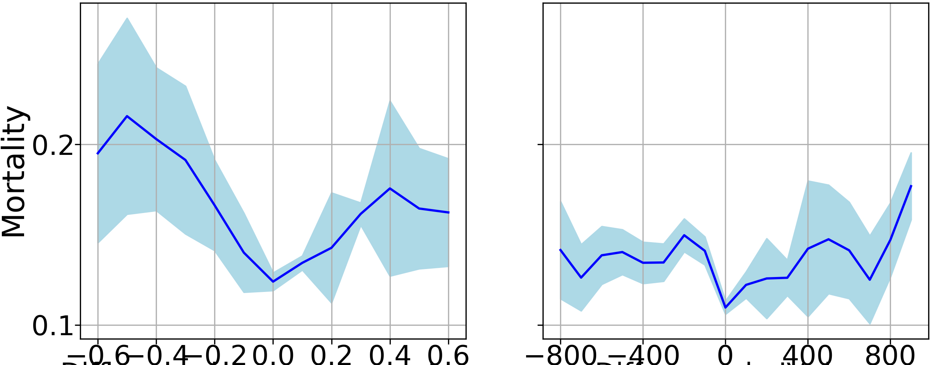
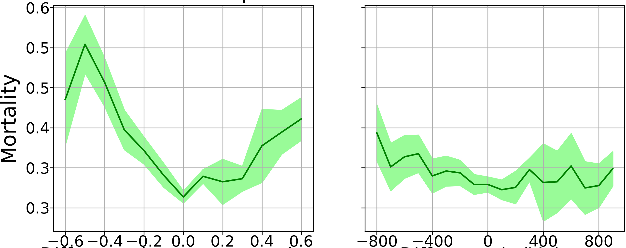
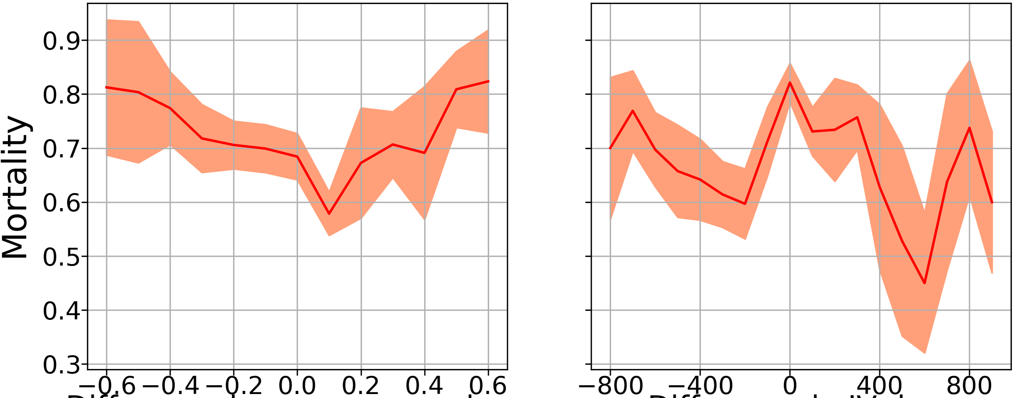
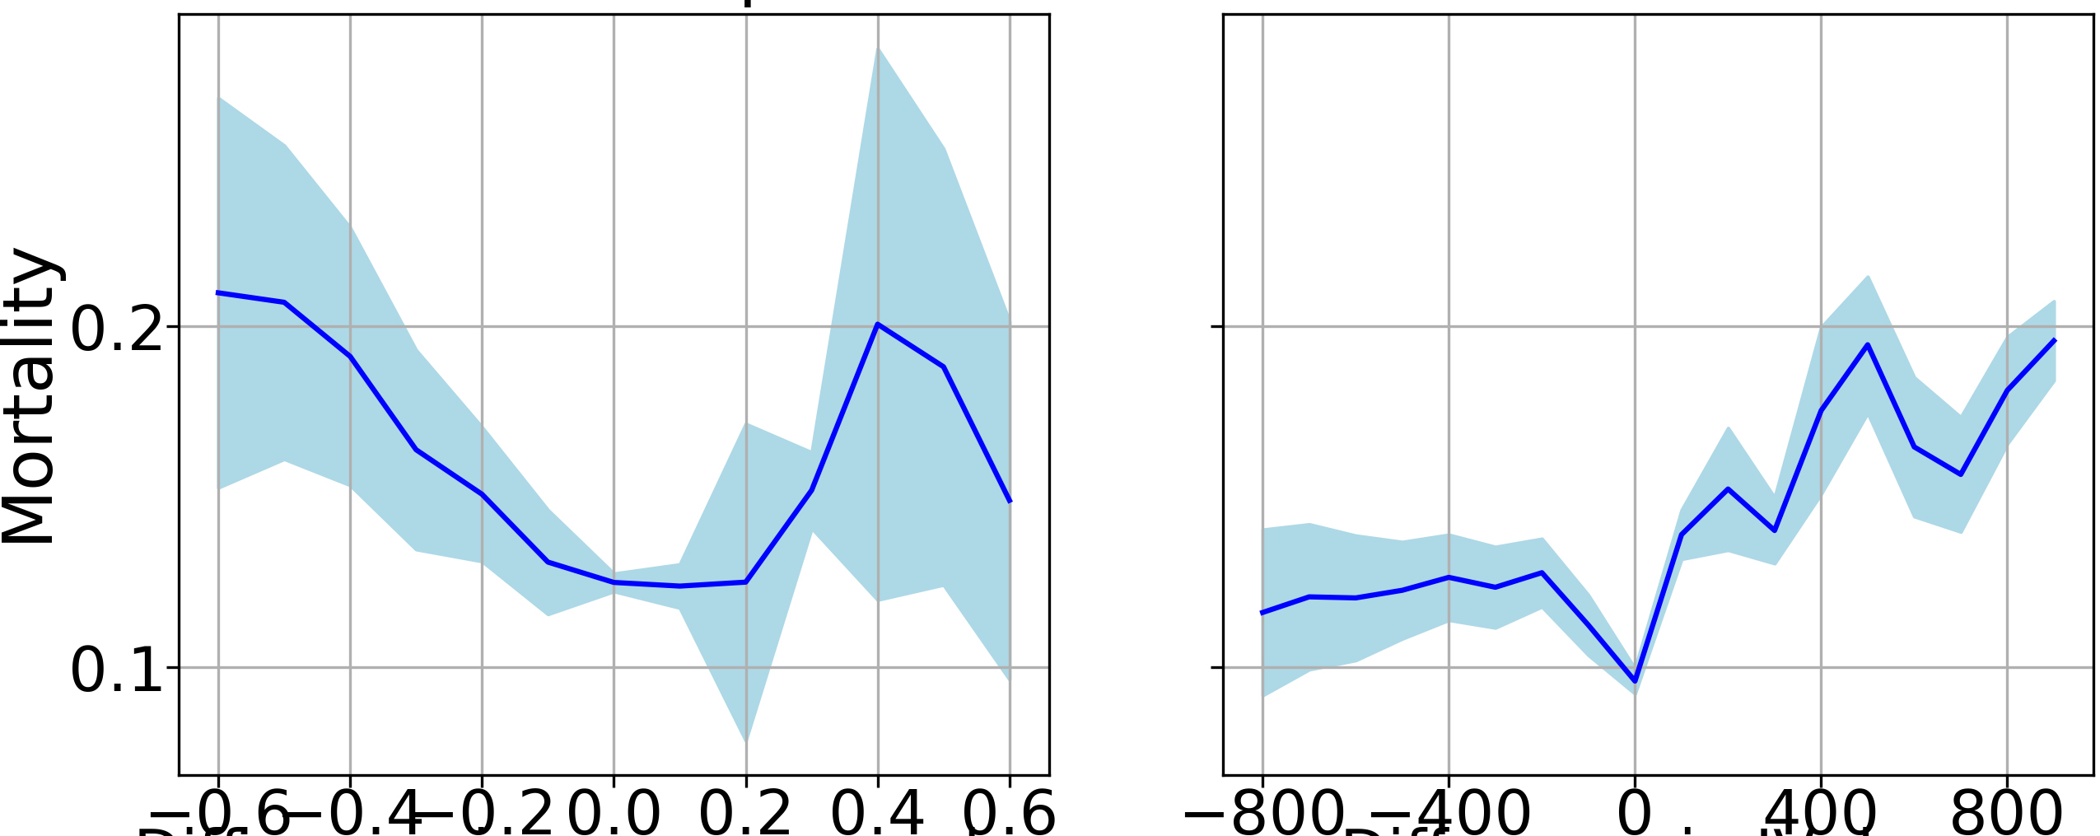
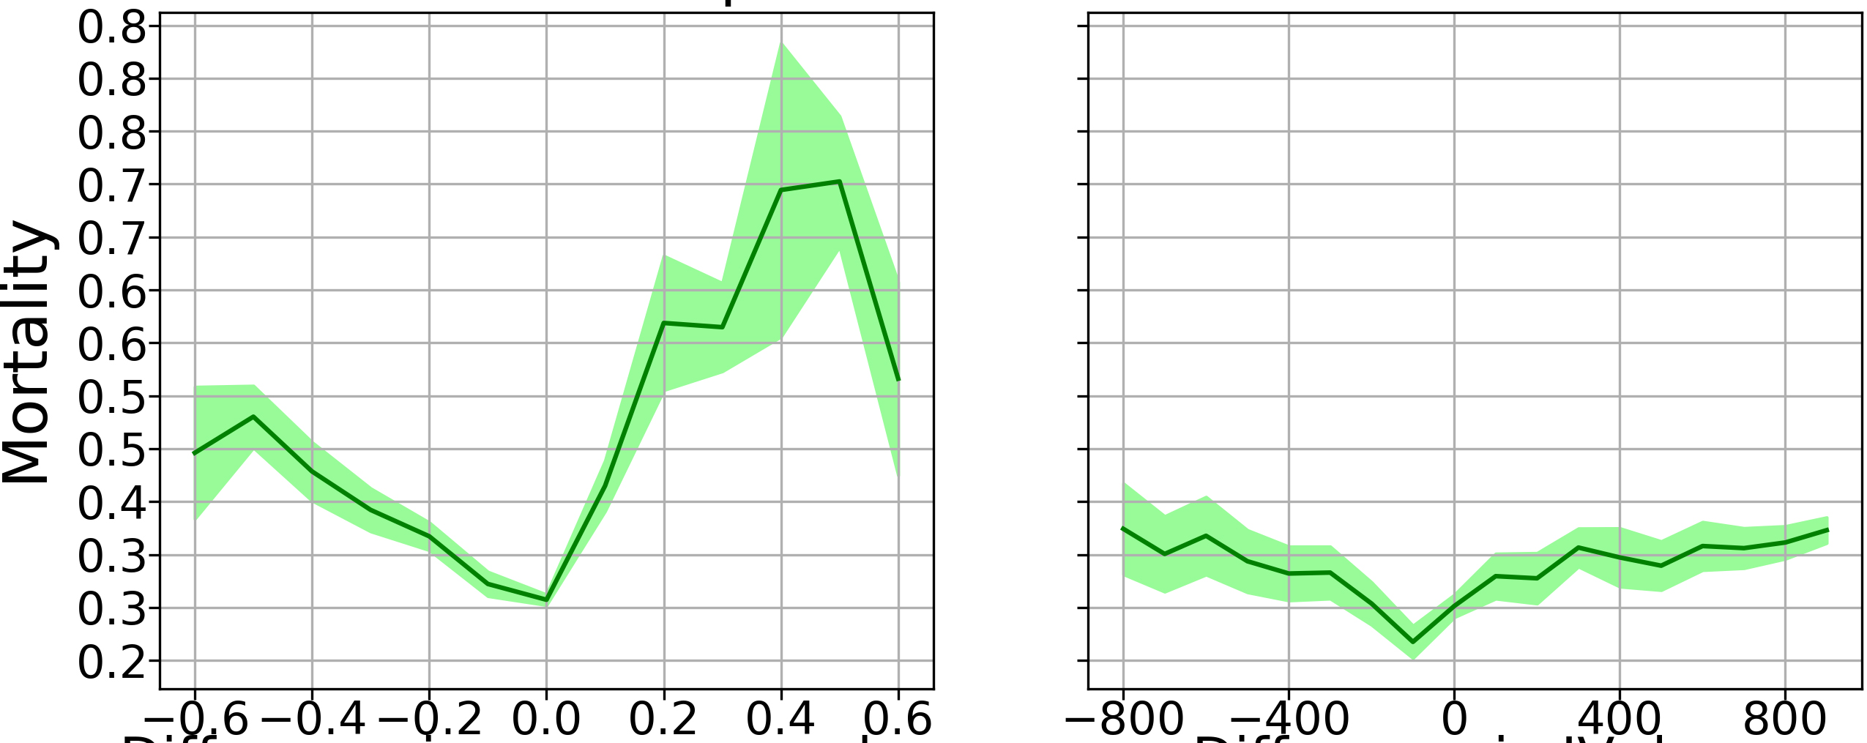
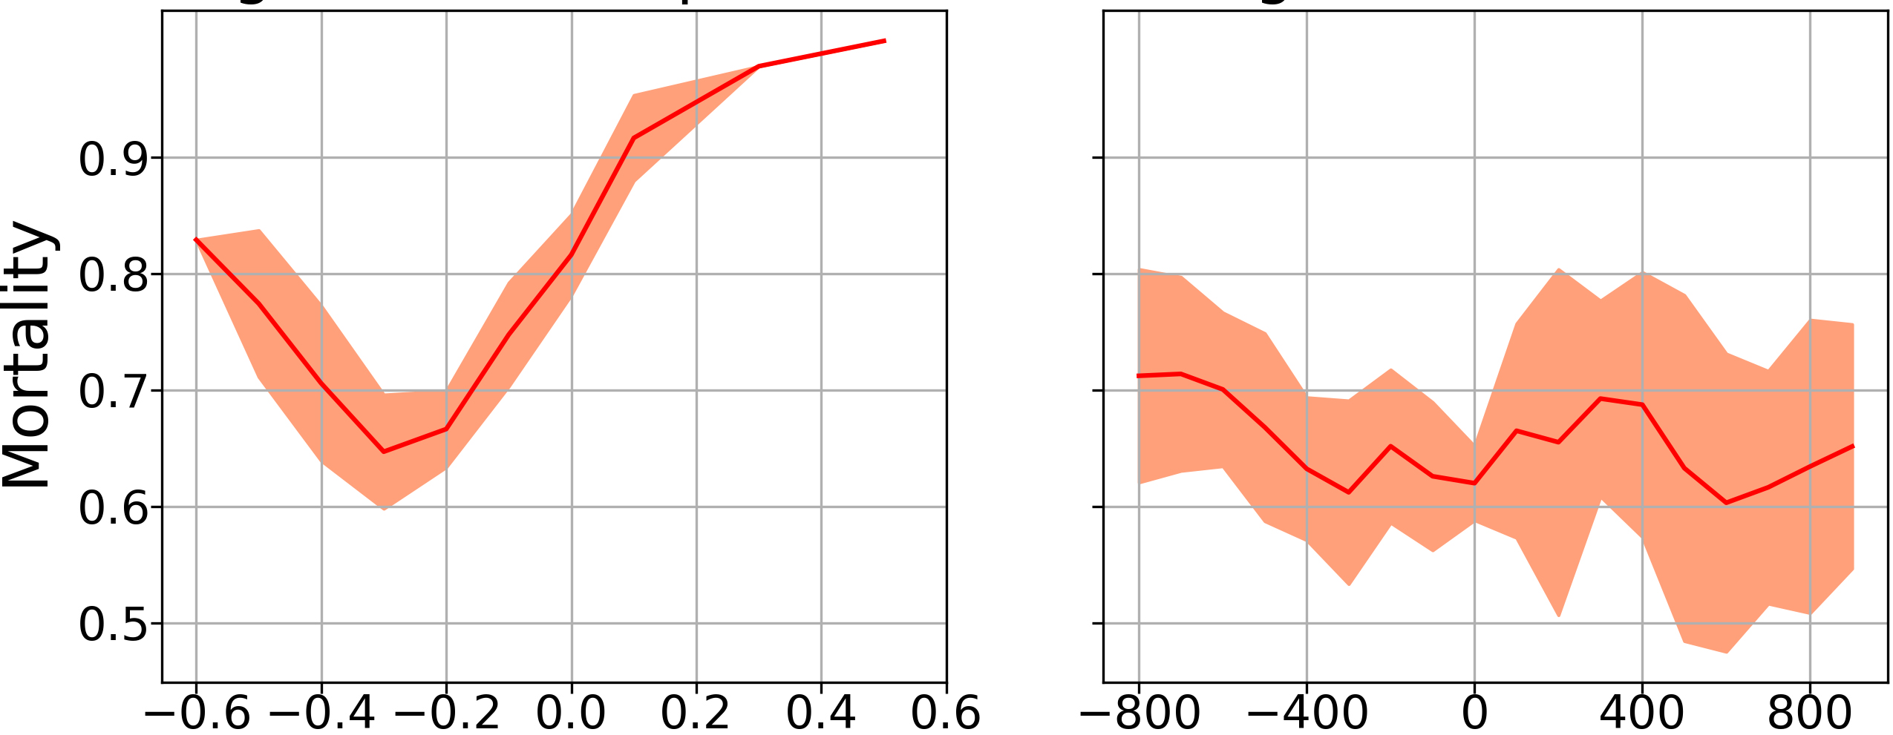















Experimental Results
Q1: Does the proposed approach lead to effective treatment policies?
$$Low risk$$
$$Medium risk$$
$$High risk$$
$$Difference in vaso dose$$
$$Difference in IV dose$$
$$Difference in vaso dose$$
$$Difference in IV dose$$
$$Difference in vaso dose$$
$$Difference in IV dose$$
$$QMix−D$$
$$QMix−D$$
$$QMix−D$$
$$Difference in vaso dose$$
$$Difference in IV dose$$
$$Difference in vaso dose$$
$$Difference in IV dose$$
$$Difference in vaso dose$$
$$Difference in IV dose$$
$$Prop−C$$
$$Prop−C$$
$$Prop−C$$

Slide 14
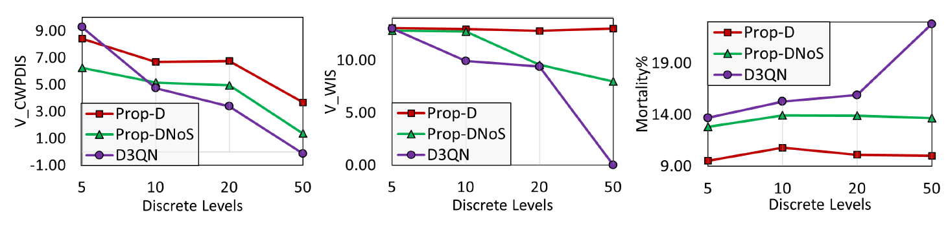



Experimental Results
Q2: Does the hierarchical approach effectively handle complexity?
$$V^{CWPDIS}$$
$$V^{WIS}$$
$$Mortality(\%)$$
D3QN : Best performing baseline
Prop-D : Proposed approach with the discrete action space
Prop-DNoS : Proposed approach without the novel patient state representation
Baselines tend to fail catastrophically under high complexity
Proposed hierarchical approach helps maintain performances under high complexity

Slide 15
Experimental Results
Q3: Is the proposed patient state representation effective and generic?
Effectiveness: With the proposed state representation,
  Discrete space: Prop-D and D3QN models decreased mortality by 26%
  Continuous space: Prop-C and QMix-C baselines decreased mortality by 35% and 8%, respectively
Generalizability: Considerably improved an auxiliary treatment prediction task,
  Improved accuracy in Linear Regressor model by 14%, respectively
  Improved accuracy in Neural Network model by 17%, respectively

Slide 16

Thank you
Scan the QR for codes, architecture diagrams, baseline implementations and additional experimental results.

